Slide 1
Investigating the Economic Health of the United Nations
Peter Ilhardt
July 19, 2019
Image: NASA Visible Earth

Slide 2
UN Charter: “Achieve international co-operation in solving international problems of an economic, social, cultural, or humanitarian character.”
Image: World Bank, 2014

Slide 3
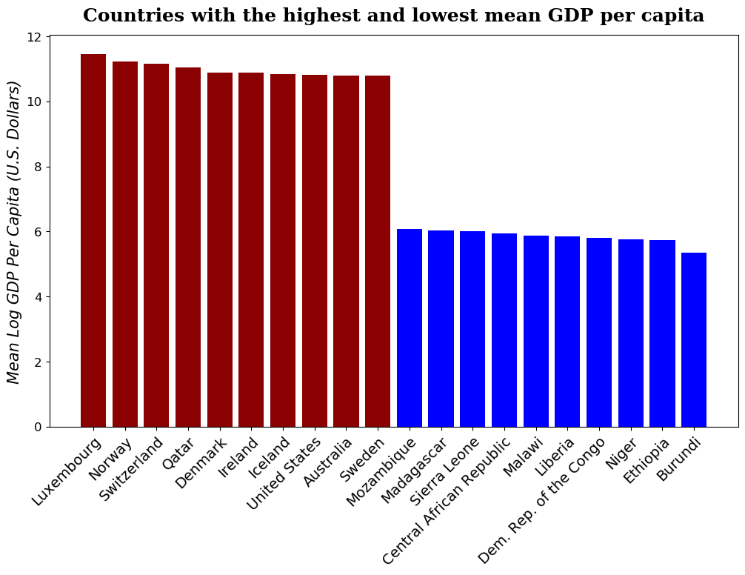
What Factors Most Influence a Nation’s Wealth?
Sources: United Nations Statistics Division (UNdata), Wikipedia
Data: Economic and social aggregate metrics for 182 nations as measured in 2005, 2010, and 2015
Aim: Predict GDP per capita in 2015 and determine most predictive metrics
Methods: Multiple linear regression with regularization

Slide 4
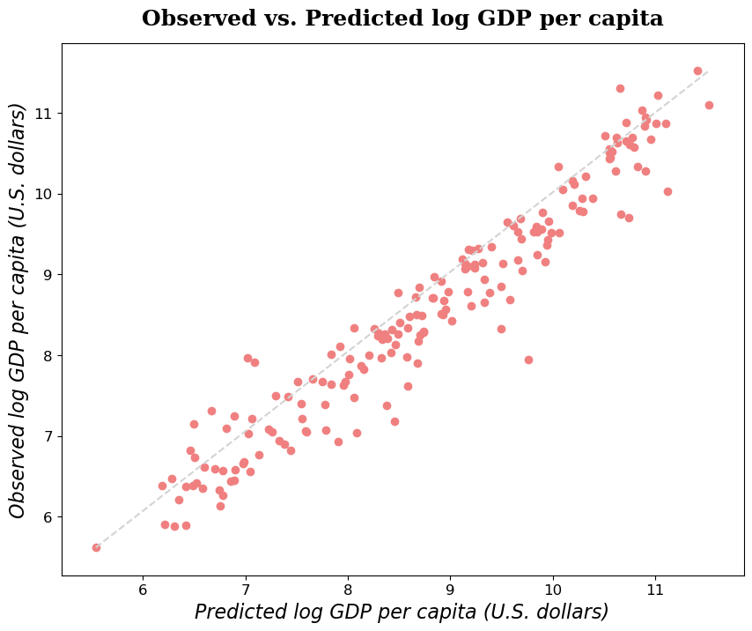
Predicted ~90% of Variance in 2015 Data
Best Predictive Model had R² value of 0.905 on test data (0.953 on training data)
Typical deviation of ~$1.50 U.S.
Effectively reproduced GDP calculation

Slide 5
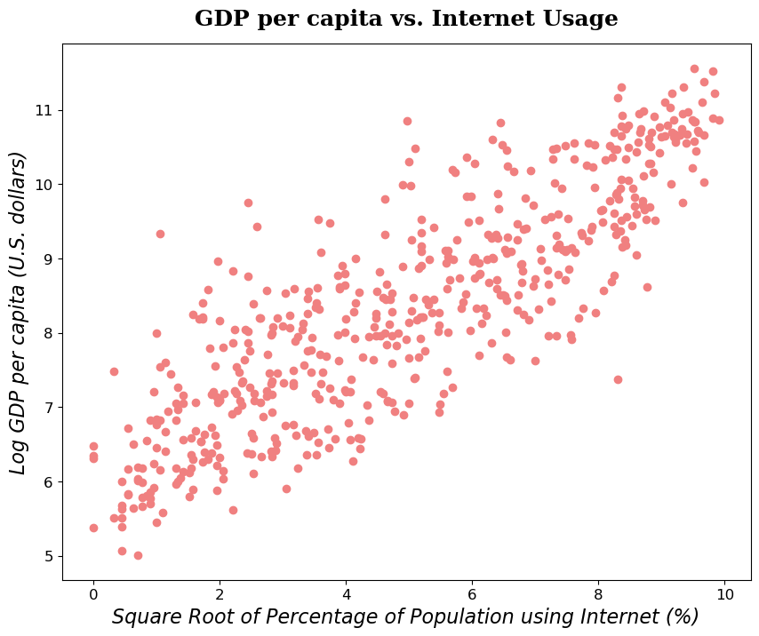
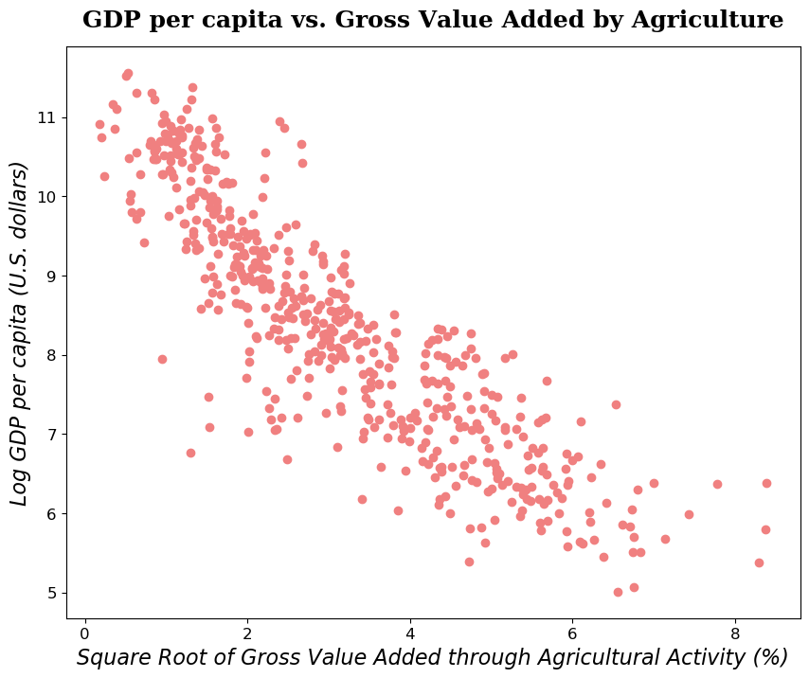
Strongest predictors largely economic indicators, but not entirely

Slide 6
Which Features Were Significant?
Not Predictive | Positively Related | Negatively Related
Exports - Imports Difference | Percentage of Population using Internet | Gross Value Added by Agriculture
Year-to-Year Population Gain | Tourism Expenditure | Infant Mortality Ratio
Total Population | Energy Consumed per Capita | Maternal Mortality Ratio
Gender Ratio | GHG Emissions per Capita | Population Density
Energy Produced per Capita | Life Expectancy | Labor Force Participation Rate
Percentage of GDP Spent on Health | Percentage of Population Being Migrants | Unemployment Rate

Slide 7
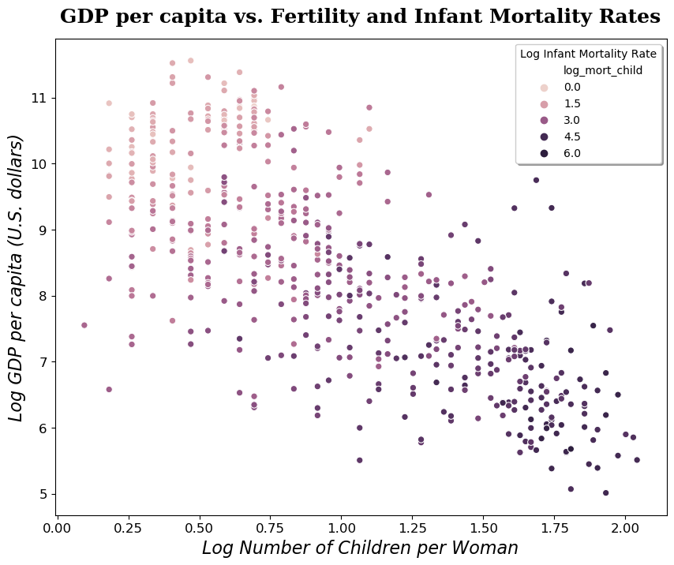
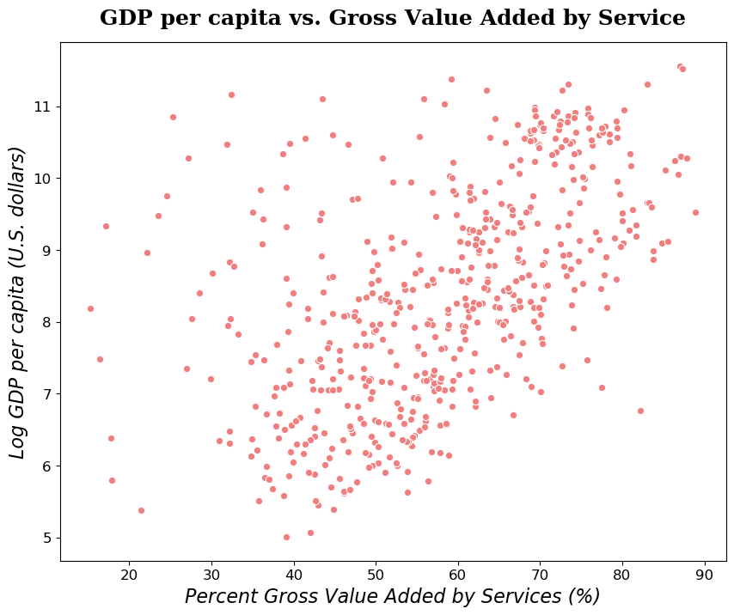
Interpretations often hindered by multicollinearity and confounding
𝛃 = +0.3
𝛃 = -0.03

Slide 8
Key Insights
Regularization offered little improvement in predictive performance, but effectively de-emphasized redundant features
Countries with higher GDP per capita characterized by better access to healthcare and technology, larger energy consumption/GHG emissions, service-driven economies, and diverse urban populations
Social metrics such as education, gender distribution, and population growth largely non-predictive, but family size surprisingly relevant

